Slide 1
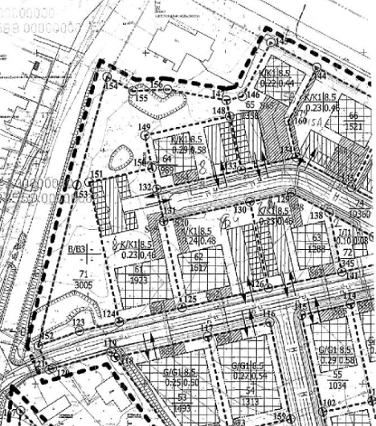
Commercial Land
Rokiskis District Municipality Administration
Plan of the land Photo of the land
Address | Rokiskis town, Pagojės str. 4
Lot size | 0,1617 Ha
Electricity | 300m distance to substation of power system
Water | 140 m, d200 mm distance to water network
Telecommunications | 140 m distance to internet, telephone network
Distance to the main road | 0,1Km
Price/other conditions | Has not offerred for sale at an auction Detailed plan has prepared Land is commercial

