Slide 1
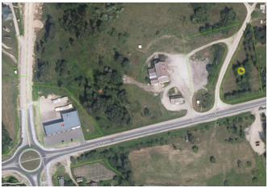
Commercial Land
Rokiskis District Municipality Administration
Plan of the land Photo of the land
Address | Rokiskis town, Taikos str.16
Lot size | 0,6616 Ha
Electricity | 90 m distance to substation of power system
Water | 20-50 m, d100 mm distance to water network
Telecommunications | 20-50 m distance to internet and telephone network
Distance to the main road | 0,003 Km
Price/other conditions | Has not offerred for sale at an auction Detailed plan has prepared Land is commercial

