Slide 1
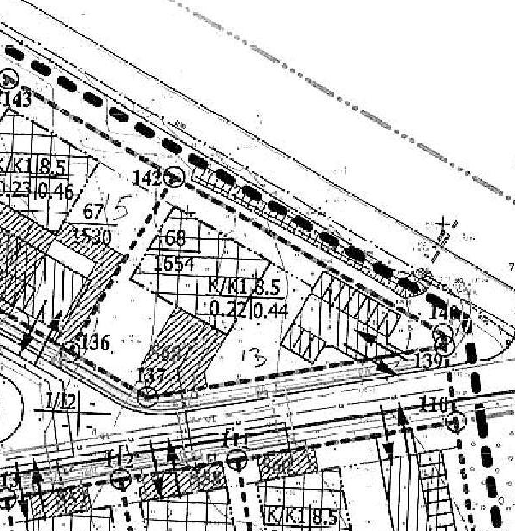
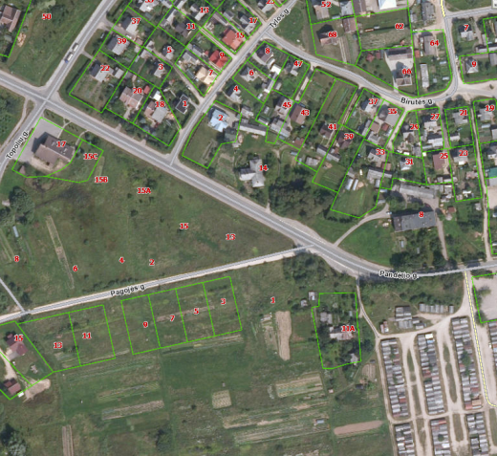

Commercial Land
Rokiskis District Municipality Administration
Plan of the land Photo of the land
Address | Rokiskis town, PANDĖLIO str. 13
Lot size | 0,1599 Ha
Electricity | 200m distance to substation of power system
Water | 80 m, d100 mm distance to water network
Telecommunications | 20 m distance to internet, telephone network
Distance to the main road | 0,02Km
Price/other conditions | The lot is formed. Method of land use: Territories of commercial objects

