Slide 1

Construction of multifunctional sports hall in Rokiškis
Rokiškis District Municipality
Notes:
Spustelėkite norėdami įtraukti pastabų

Slide 2

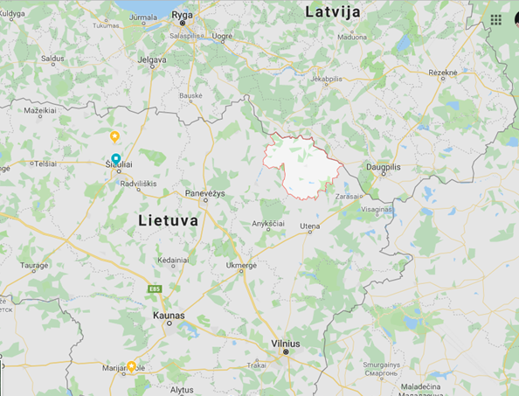
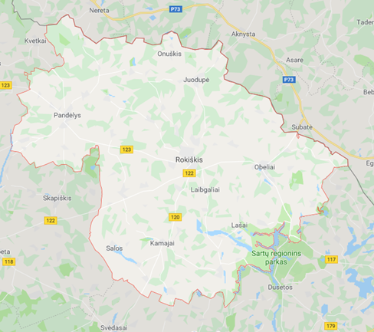
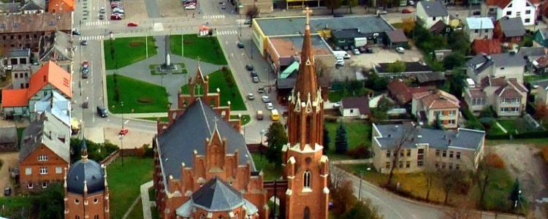
Rokiškis District Municipality
Administrative teritorial unit in north-east part of Lithuania, shares border with Latvia. Center– Rokiskis.
Area: 1 807 km²
Inhabitants (2018 year): 29472
Density of population : 20,4 inh./sq²
Towns: Obeliai; Pandėlys; Rokiškis
Representative authority– Rokiskis District Council, executive authority – Rokiškis District Municipality Administration.

Slide 3

Construction of multifunctional sports hall in Rokiškis
Aim of the project
Improve the quality of sports service in Rokiskis, and make the development of sports objects
Objective of the project
Implement developement of sports infrastructure in Rokiskis

Slide 4
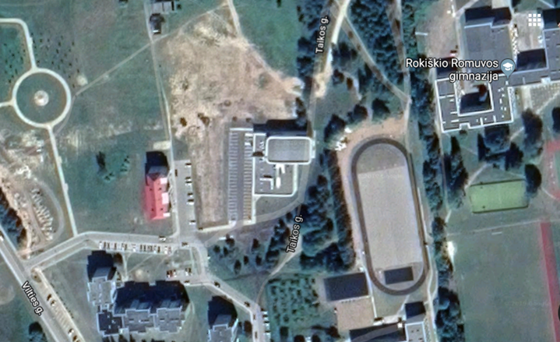
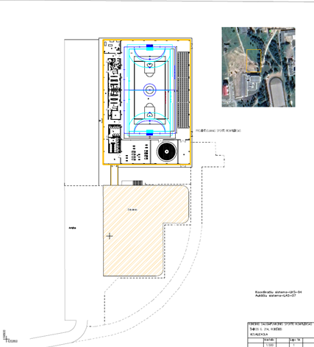
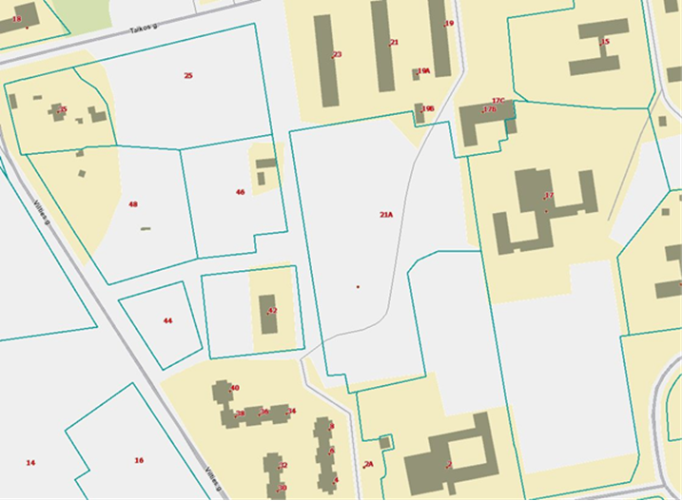
Territory of the project
Land (Taikos str. 21A, Rokiškis) has 2,6432 hectares of area. In the same land Rokiskis swimming pool has been constructed in 2018 (area of building– 1510 sq. m.), the aims are: 1) to supply swimming pool, sauna, bath, leasure time, health and other services to community, organize sports and entertainment events, develop infrastructure of services, insure quality and effectiveness; 2) organize non-formal education to children and adults, and (or) formal supplementary education; 3) to implement health, social welfare, promotional services, forster the developement of leasure time activities and development of entertainment activities; 4) implement youth occupation programme; 5) participate in local, regional, international events; 6) motivate disabled people and people with special needs to participate in sports activities; 7) propogate body culture and sports; 8) take part in development of Rokiskis tourism sector infrastructure, and promote leasure time, sports and recreational service to local and international guests; 9) to create material infrastructure which is inevitable for implementing health, recreation, sports and active leasure time services.

Slide 5
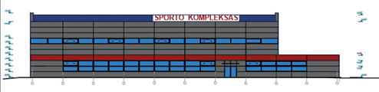
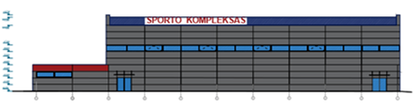
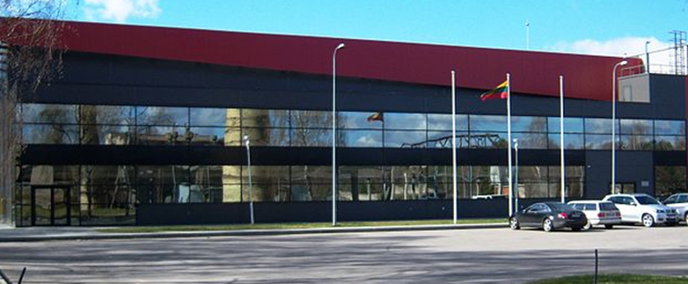
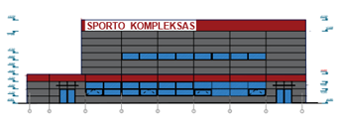
General building indicators
Total area – 2.456,19 m2
Volume of the building– 28.922,26 m3
Height of the building – 12,70 m
Occupied area– 3079,44 m2
Preliminary value -2964467,27 Eur

Slide 6
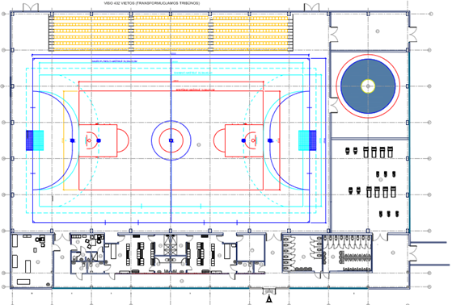
Explication of the premises :
Multifunctional sports hall– 1.617,22 m²
Wrestling hall - 154,41 m²
Weightlifting and training hall- 167,30 m²
Medicine room - 51,02 m²
Dressing room (men) – 40,61 m²
Dressing room (women) – 40,80 m²
WC, adopted to disabled – 8,21 m²
WC, showers to sportsmen – 21,70 m²
Dressing room for coaches - 12,69 m²
WC, showers to coaches – 5,81 m²
Premises to inventory, utility room – 87,92 m²
WC to visitors (women) – 32,85 m²
WC to visitors (men) – 41,23 m²
Halls, other premises – 174,42 m²

Slide 7
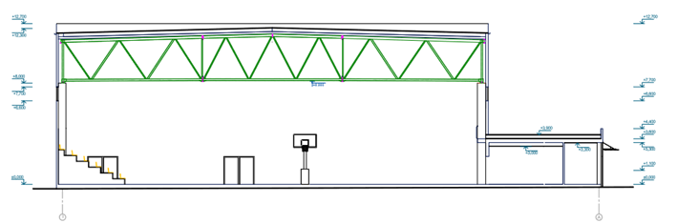
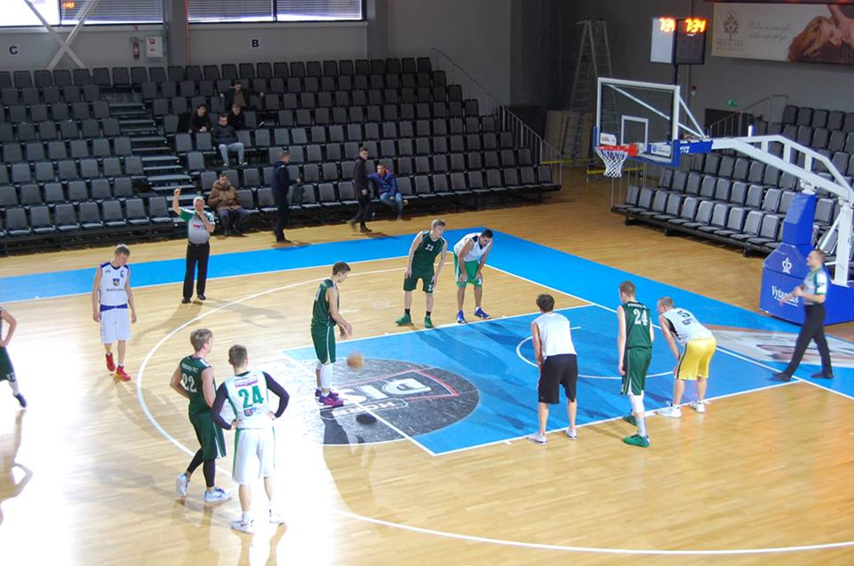
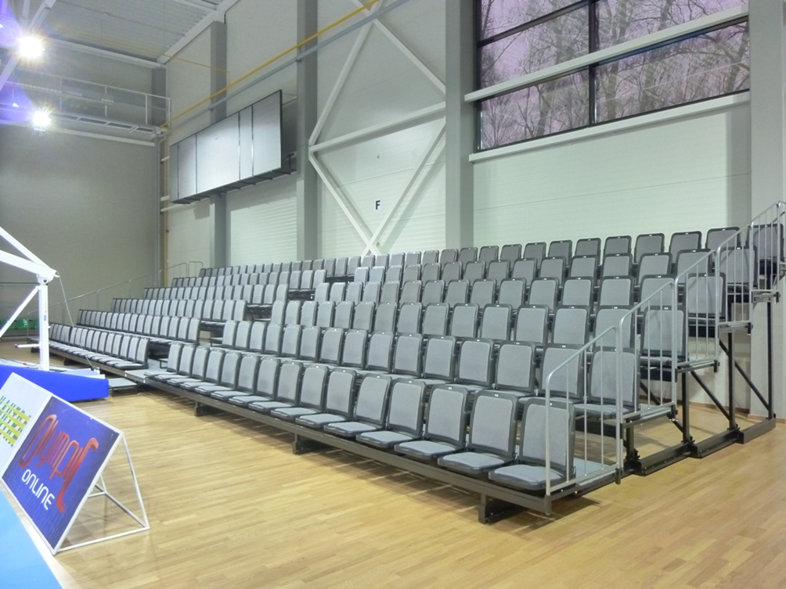
General indicators of the building
General maximum number of people in premises - 650
Number of sitting places to spectators – 432 (transforming platforms)
Number of sportsmen – 200
Service staff– 18 people.

Slide 8
Aplicability of multifunctional sports hall :
Multifunctional sports hall– 1.617,22 m² :
Basketball hall 15,0 m x 28,0 m;
Handball hall 20,0 m x 40,0 m;
Football hall 25,0 m x 42,0 m;
Training hall (2 basketball halls);
Volleyball hall 9,0 m x 18,0 m;
Lawn tennis hall 10,97 mx 23,77 m;
Organizatiohn of mass events, concerts, shows.
Wrestling hall 154,41 m²:
Greek roman wrestling,
Judo and other ring sports trainings and competitions;
Yoga, meditations, body streching, warming-up before competitions;
Trainings for sports dance.
Weightlifting and training hall - 167,30 m²
Trainings and competitions of weightlifting;
Physical preparation, fitness, cardio trainings.

Slide 9
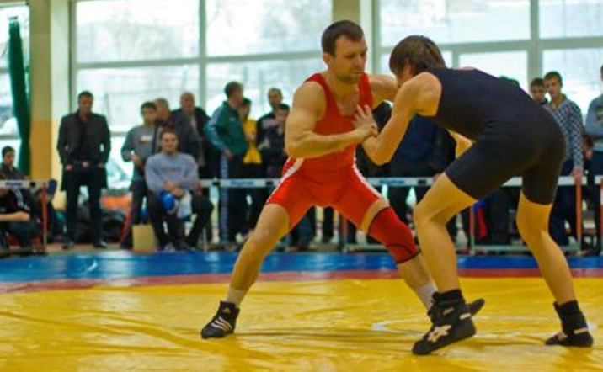
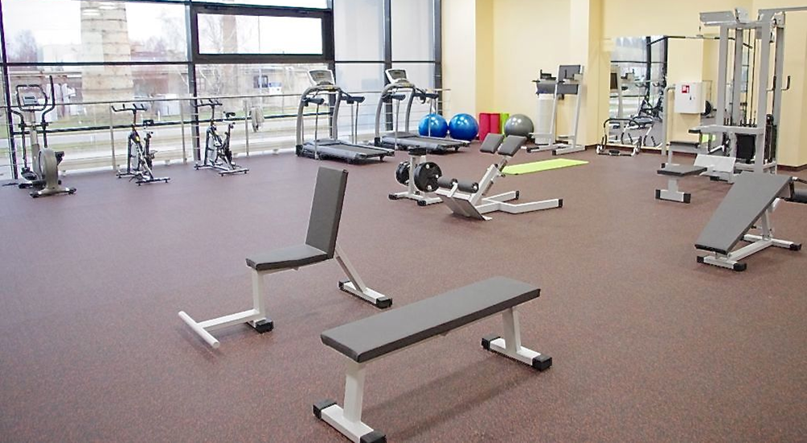
Investment to construction of the object:
Preparation of land – 119,62 thousand Eur;
Construction of the building – 1.081,53 thousand Eur;
Decoration of the building– 452,52 thousand Eur;
Water supply, sewerage– 63,76 thousand Eur;
Heating, cooling, air-conditioning – 323,81 thousand Eur;
Electrotechnics – 179,20 thousand Eur;
Electronic communications – 6,86 thousand Eur;
Protective alarm system– 22,01 thousand Eur;
Fire alarm system– 14,72 thousand Eur;
Sports equipment – 261,45 thousand Eur;
Engeneering infrastructure– 107,64 thousand Eur;
Alternative energy sources – 190,18 thousand Eur;
Engeneering services – 141,17 thousand Eur;
In total: about 2964,47 Eur.

Slide 10
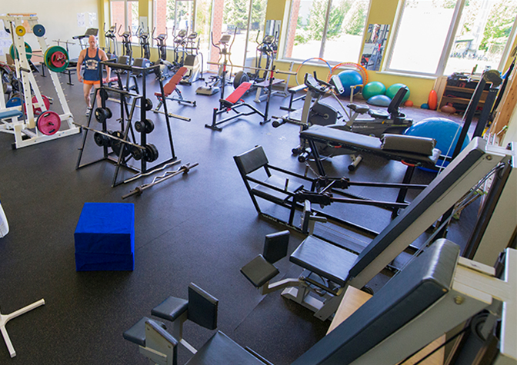
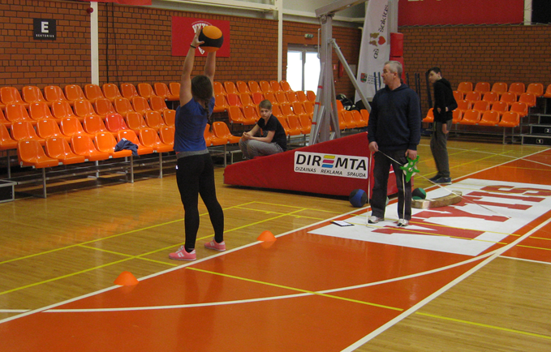
Final beneficieries:
There are three main groups, who will get direct and indirect advantage of the project:
1. Inhabitants of Rokiskis District Municipality. Scope of the group – 28728 inhabitants (in accordance with the prior data of the begginning of 2019, provided by Statistics Lithuania Department), direct beneficieries of the project are the following:
People who train in Rokiskis District Municipality – 2147 persons (in accordance with the data provided by Body culture and Sports Department, 2017);
Caoches – 17 persons (in accordance with the data provided by Body culture and Sports Department, 2017);
Volunteers – 133 persons (in accordance with the data provided by Body culture and Sports Department, 2017);
Participants of sports competitions and entertainment events 10172 persons (in accordance with the data provided by Body culture and Sports Department, 2017);
Schoolchildren who attend body culture lessons in Rokiskis District Municipality – 3185 persons (in accordance with the data priocided by Statistics Lithuania in 2017-2018).
Body Culture and Sports Center of Rokiskis Region.

Slide 11
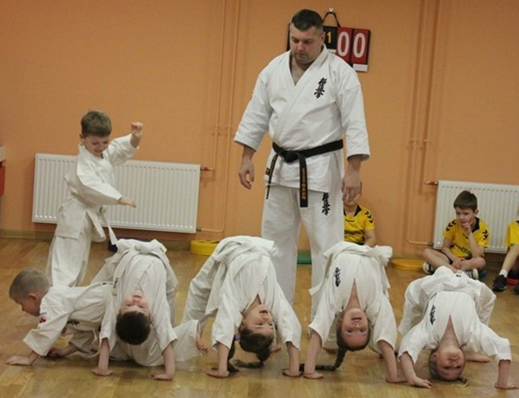
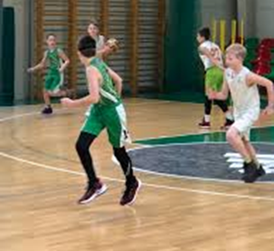
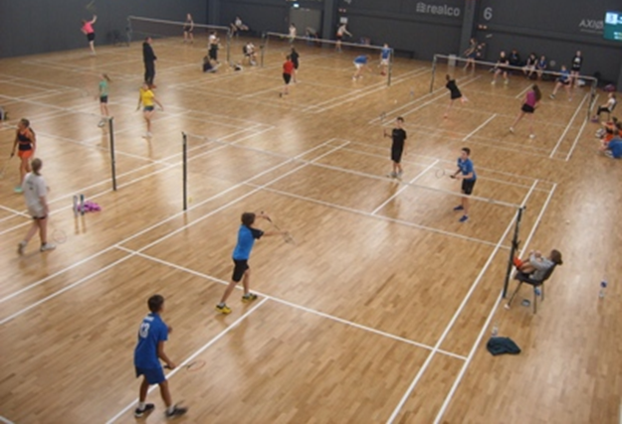
Revenue:
Revenue – income generated from sale of goods or services. In this case revenue is income from taxes for the usage of infrastructure.
Anticipated income:
rent of sports hall. It is anticipated that hall will be rented for 1800 hours per year, rent for one hour-20 Eur. Starting from the year 2023, annual income from rent will be 36000 Eur.
Income from events. Price for one event - 10 Eur. It is anticipated, that annually 50 competitions/events will be organized, 40 percent will be paid, i.e. 20 competitions/events. 432 persons will come to one event, so the revenue from competitions/events will be 86400 Eur (20 events x 432 persons x 10 Eur = 86400 Eur).
Income from sports trainings will be about 1000 Eur per month, trainings for children will be held 10 months, so annual income - 10000 Eur.

Slide 12
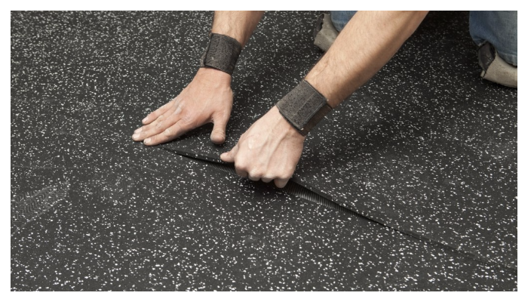
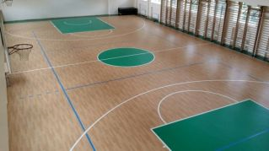
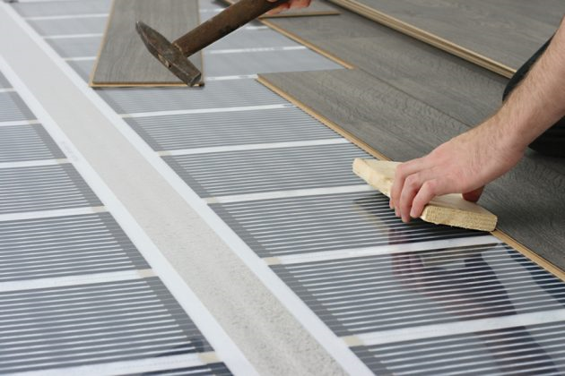
Duration and stages of the project :
Implementation of the project - 36 months, from January, 2020 till December, 2022.
In case the project will not receive finance the start date of the project can be changed, but the implementation period remains the same.
The period is real for anticipated construction works and other works.
Project will not be divided into stages.

Slide 13
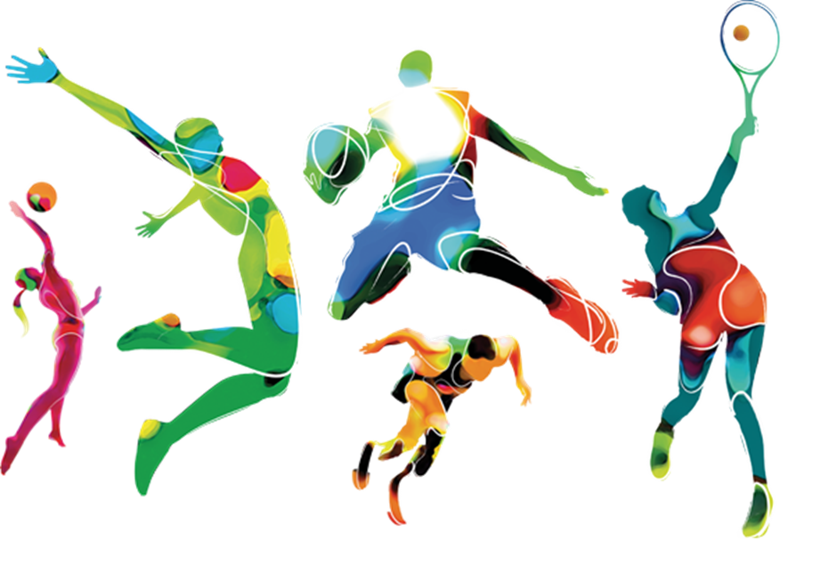
Investors are welcome!
Contacts:
Rokiskis District Municipality Administration
Respublikos str. 94, LT-42136, Rokiškis
Phone: (8 458) 71 233, fax. (8 458) 71 420
Code of institution: 188772248
Email: savivaldybe@post.rokiskis.lt
Strategic Planning, Investments and Public Procurement Department
Phone: (8 458) 71 407, mob. 8 698 38826
Email: v.meciukoniene@post.rokiskis.lt

